Slide 1
Fuzzy Logic Systems
Chathura Rajapakse D.Eng.
Department of Industrial Management
Faculty of Science
University of Kelaniya

Slide 2
What is it?
A technique that allows for the inclusion of vague human assessments in computing problems
New computing methods based on fuzzy logic can be used in the development of intelligent systems for decision making, identification, pattern recognition, optimization, and control
-Harpreet Singh, et al. 2013

Slide 3
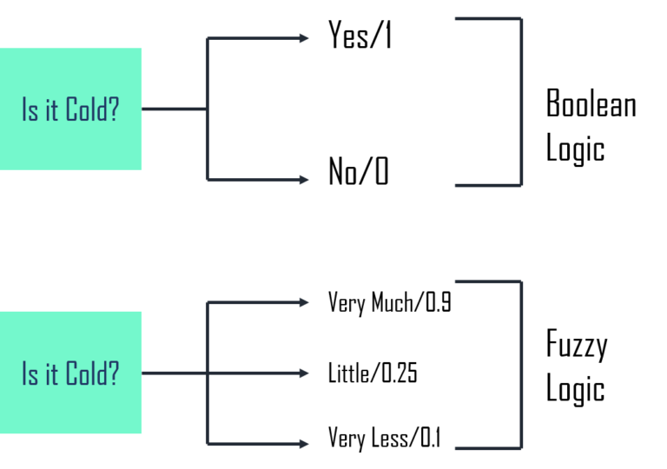
Binary Vs. Fuzzy Logic
Edureka.com

Slide 4

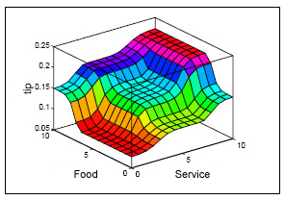
How do you give a tip at a restaurant?
Do you measure the taste of food and quality of service, and then decide the tip?
Or else would you rely on linguistic rules as follows?
Closer to human way of thinking as well
Non-linear

Slide 5

Fuzzy logic
  Developed by Lotfi Zadeh in 1965
  Based on a system of non-digital (continuous & fuzzy without crisp boundaries) set theory and rules.
    An accurate quantitative model is not required to control a plant or determine appropriate action.
    The key advantage is its ability to deal with vague systems and its use of linguistic variables.
    Leads to faster and simpler program development of system controllers.
  It can be a decision support system tool for managers

Slide 6
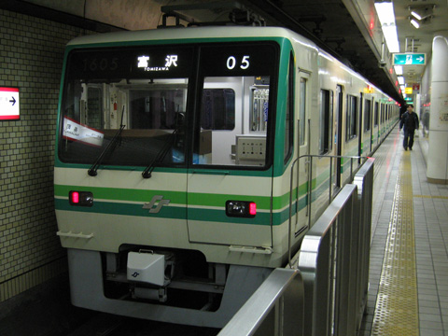
Fuzzy logic boom in Japan
  Sendai Subway automatic train operation control system – 1987
    Fuzzy system controls acceleration, deceleration, and breaking of the train
    Reduces energy consumption by 10%
    Passengers hardly feel the change of velocity of the train
    Calculations considered:
      acceleration to a target speed with velocity oscillation
      maintaining target speed (coasting)
      stopping at the correct location with velocity control for a no motion feel

Slide 7
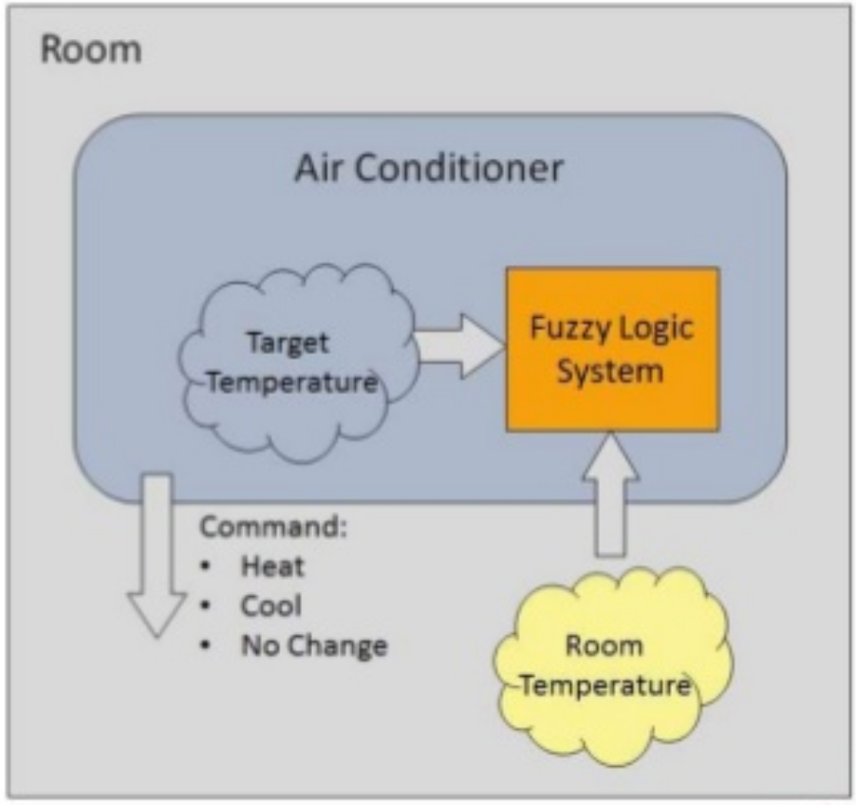
How fuzzy logic work in machines
Air conditioners
  Periodically check the room temperature against the target temperature
  Accordingly decides whether to cool, or heat the room

Slide 8
Crisp sets Vs. Fuzzy sets
Crisp set:
  An element is either a member of the set or not
  Most of the things that we deal with in our life belong to crisp sets
  It’s a car, for example
  The car is ‘Red’, is another example
Fuzzy set:
  An element has a partial membership to a set
  The current distance to the car in front can be a partial member of the class ‘far’ as well as ‘close’
  ‘Sue is tall and short’ !!

Slide 9
Fuzzy Logic Terminology
Fuzzy Set: Let 𝑋 be a set. 𝑋 is a fuzzy set if each element 𝑦 of 𝑋 is characterized by a membership function 𝜇_{𝑋} 𝑦 :𝑋 ↦ [0,1]
  That is, 𝜇𝑋(𝑦) is a value in the range 0 to 1, describing the degree of membership of 𝑦 within the set 𝑋
  Ex: A given color has 0.38 membership in the set Green
Fuzzy Variable: a variable with fuzzy sets as its values
Linguistic Variable: a fuzzy variable with values that are words or sentences in a language
Linguistic Hedge: a term in a language used as a modifier of basic terms in linguistic values (e.g., very, somewhat, extremely)

Slide 10
Propositional Logic
A propositional logic uses truth statements to form or provide other truth statements (applied in the forward chaining algorithm last week)
Two types of sentences: simple and compound
  Simple sentences are propositional constants with truth values
    Cat is a mammal
    All lecturers are males
  Compound sentences are formed from simpler sentences using negations, conjunctions, disjunctions, implications, reductions and equivalences
    Sky is cloudy AND wind is strong

Slide 11
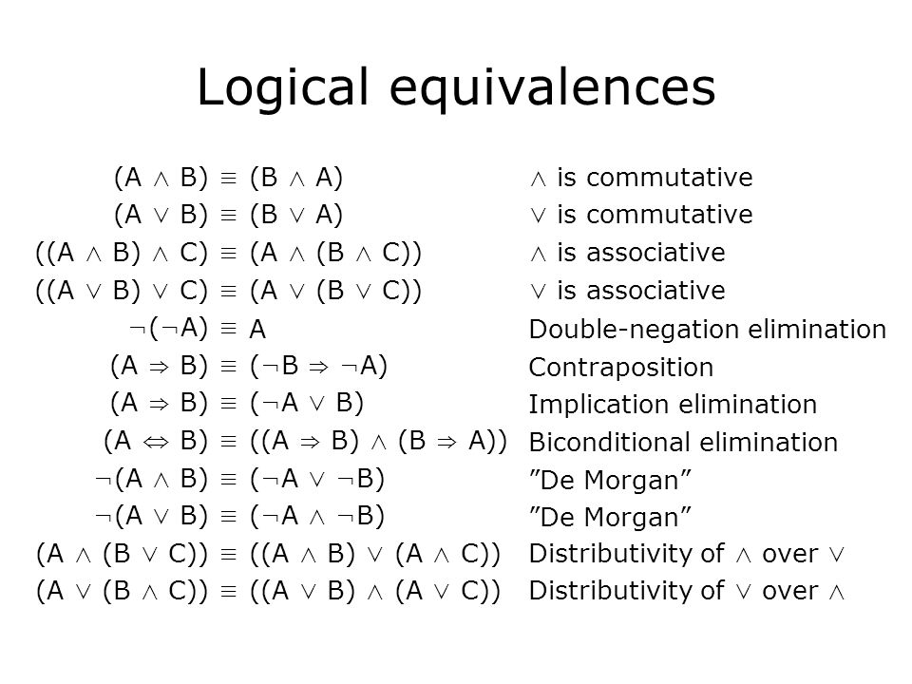

Slide 12
Fuzzy Propositional Logic
The membership degree 𝜇_{𝑋} 𝑦 represents the truth value of the sentence 𝑦 in the universe of discourse 𝑋
  0 represents absolute falsity
  1 represents absolute truth
A fuzzy proposition is a sentence such as “Joe is short” with a fuzzy truth value 𝜇_{𝑠ℎ𝑜𝑟𝑡}(𝐽𝑜𝑒)
We can also read this as: Joe is a member of the set of short people with degree 𝜇_{𝑠ℎ𝑜𝑟𝑡}(𝐽𝑜𝑒)

Slide 13
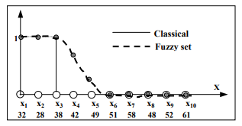

Classical sets Vs. Fuzzy sets
Set A: Faculty members of a department
Set B: Faculty members who are young (i.e., below 40)
In traditional crisp sets:
  Set B only contains {x1, x2, x3}
In fuzzy implementation:
  X4 and x5 could be defined as having partial memberships

Slide 14
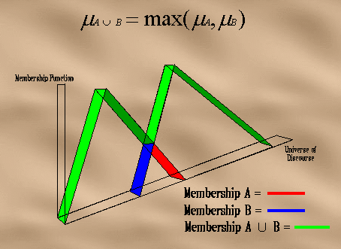
Fuzzy set operations
Union

Slide 15
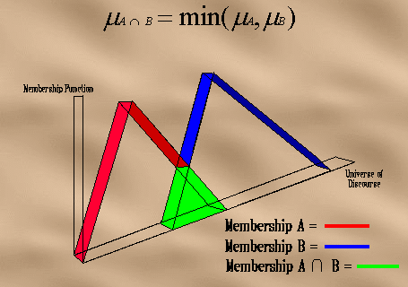
Fuzzy set operations
Intersection

Slide 16
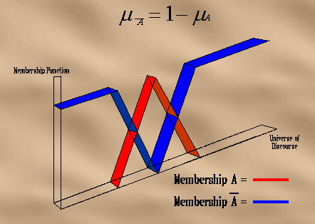
Fuzzy set operations
Complement

Slide 17
Fuzzy Rules
If antecedent(s) Then consequent(s)
The antecedents of a rule form a combination of fuzzy sets through application of the logic operators (i.e. complement, intersection, union)
  Requires a/the crisp input(s) to be fuzzified first
The consequent part of a rule is usually a single fuzzy set, with a corresponding membership function

Slide 18
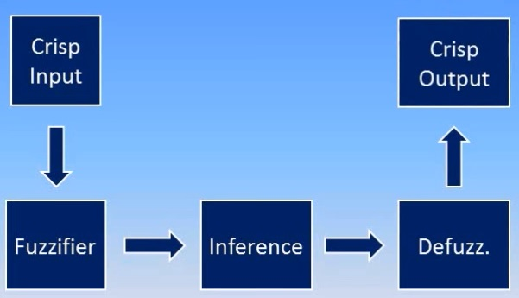
Fuzzy system components
Fuzzy Sets
Fuzzy Rules

Slide 19
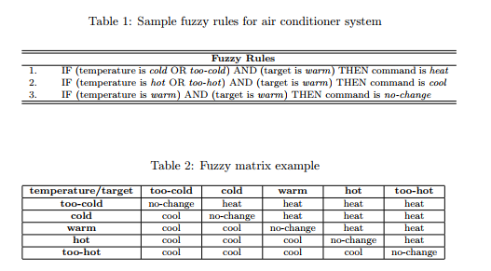
Decision process of the air conditioner
Prepared by human experts
Can go up to as many as N variables
Fuzzy associative matrix

Slide 20
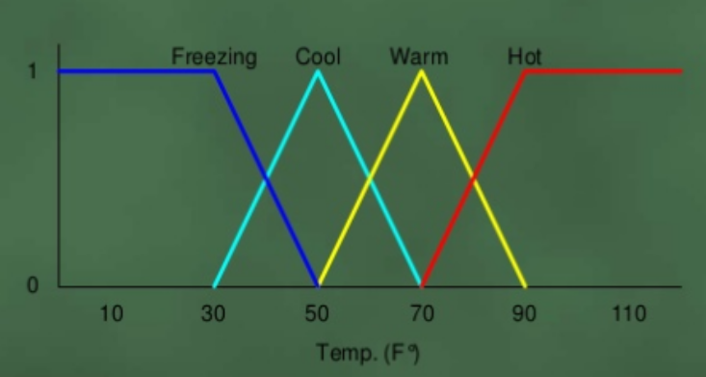
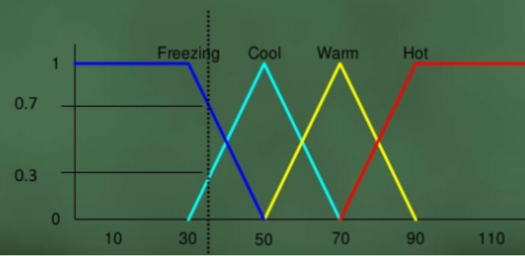
Fuzzification
Converting the crisp input values into fuzzy sets (linguistic variables)
  Done through membership functions
  Ex. Temperature is mentioned as Freezing, cold, warm or hot
  Belongingness to a particular set cannot be defined by a threshold point
  Fuzzification involves defining how much a particular value belongs to a given linguistic variable
How cool is 36 Fº

Slide 21
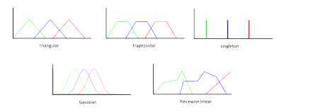
Different types of membership functions
Triangular
Trapezoidal
Singleton
Gaussian
Piecewise Linear

Slide 22
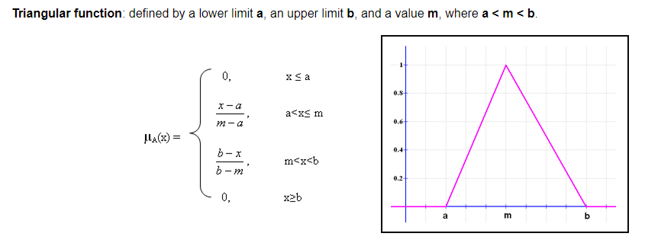
Triangular Membership Function

Slide 23
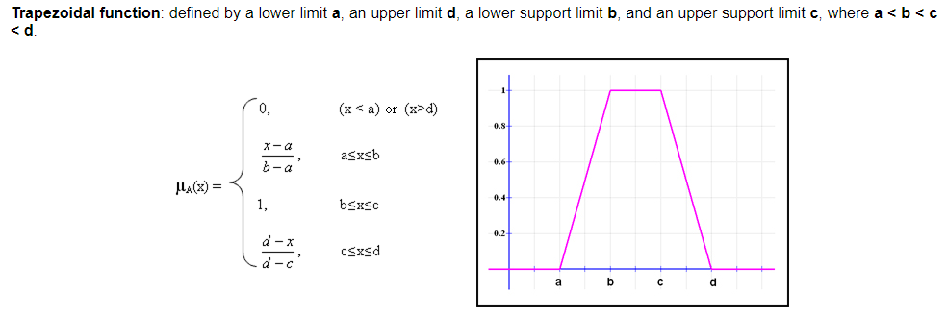

Trapezoidal Membership Function

Slide 24
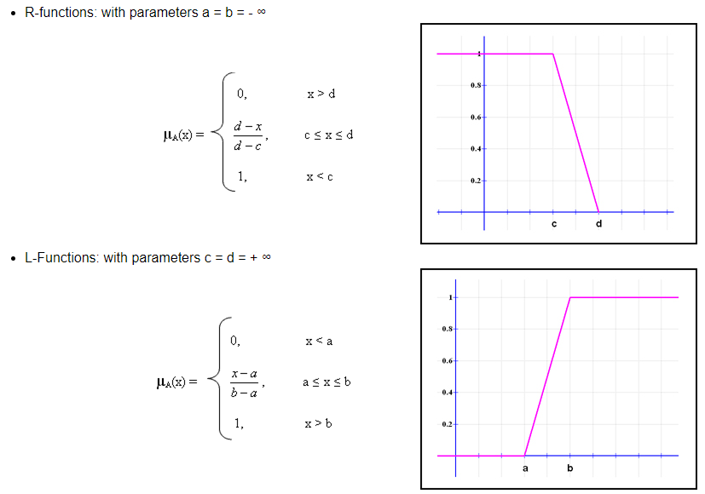
L- and R- Functions

Slide 25
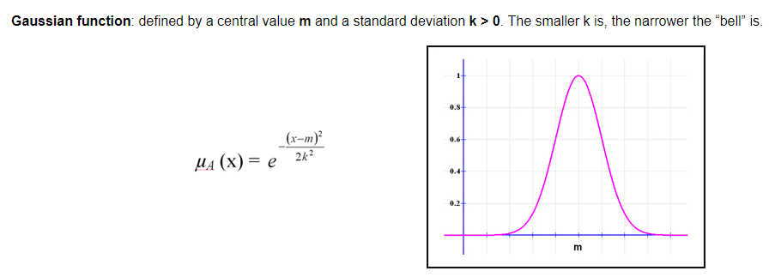
Gaussian Function

Slide 26

Inference
  Set of rules to be evaluated to derive the output
  Evaluation of rules require fuzzy set operations

Slide 27
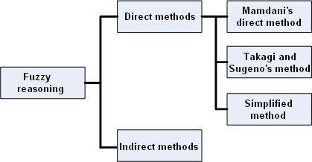
Fuzzy inference methods
Most commonly used methods are the Madmani’s method and the Sugeno’s method.
  Mainly differ in the way they take the output

Slide 28
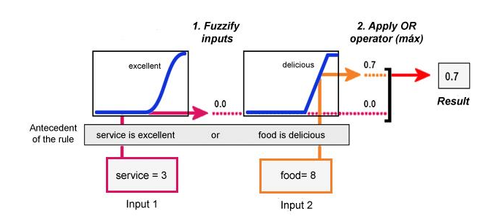
Evaluating the antecedent – Mamdani’s method
Applied for each rule

Slide 29
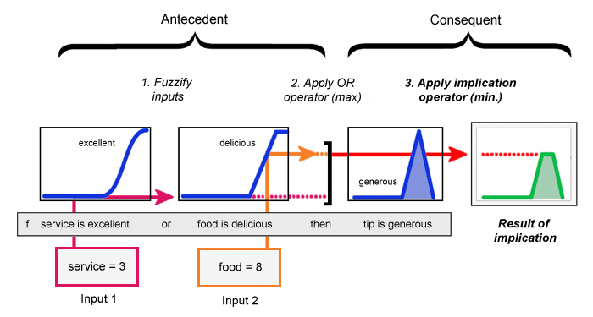
Obtaining the conclusion
Uses the minimum which truncates the membership function.
  Can also use product, which multiplies the membership function

Slide 30
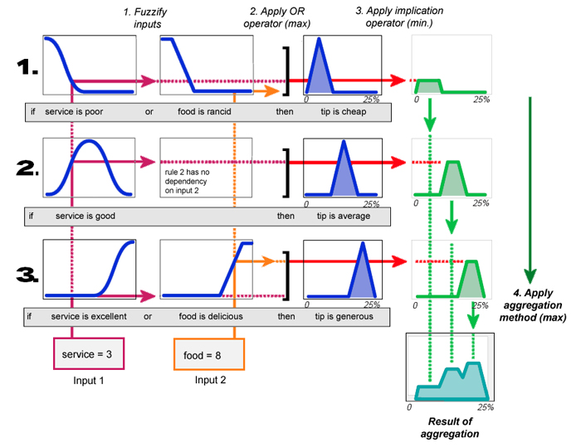
Combining multiple rules
Some of the most commonly used aggregation operators are the maximum, the sum and the probabilistic sum
Ex: Using max

Slide 31
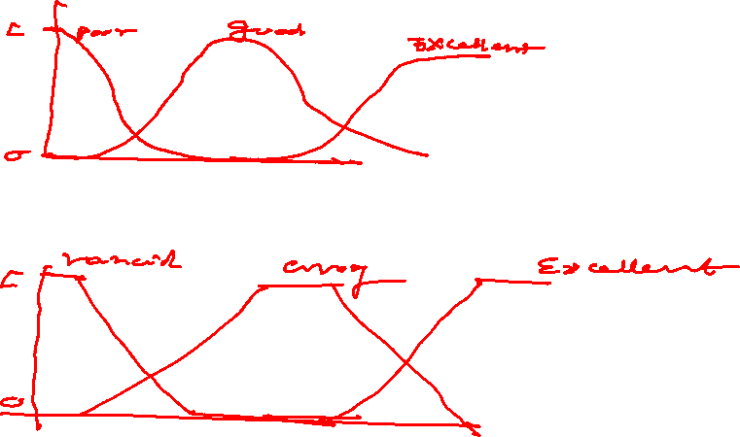

Slide 32
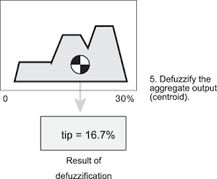
Defuzzification
The result of inference (control output) is still vague or fuzzy
Defuzzification helps getting an output suitable for real applications from a fuzzy inference
Convert the fuzzy output back to the crisp or classical output to the control objective
There are few notable methods:
  first of maximum, middle of maximum, last of maximum, mean of maximum, center of gravity (centroid)

Slide 33
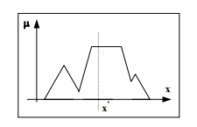


Defuzzification Techniques
Center of Gravity Method (Centroid method)
  Could be considered as the most popular technique
  The weighted average of the membership function or the area bounded by the membership function curve is computed
  If x is continuous

Slide 34
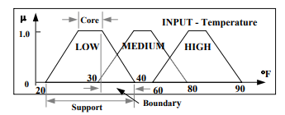
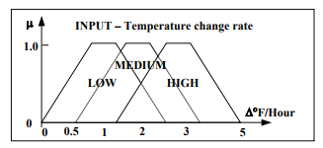
Example
Suppose an air conditioner operates with two inputs; the current temperature and the temperature change rate (change per hour)
There are two input membership functions
Membership function of temperature input
Membership function of temperature change input

Slide 35
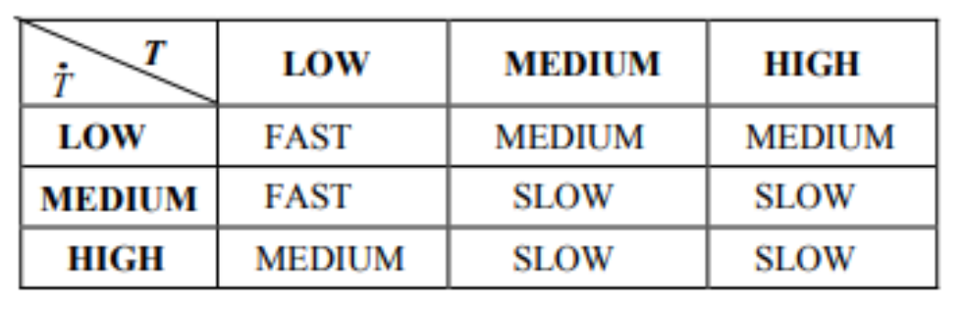
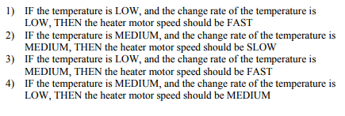
Example
Fuzzy control rules could be represented as a table
Suppose these four rules are applied

Slide 36
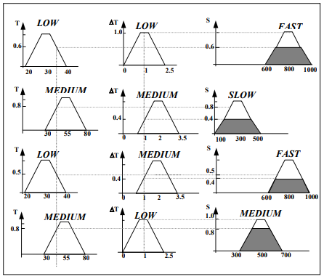
Example
The fuzzy rules could be illustrated as functional graphs
Consider a case of 35Fº temperature and and 1Fº/hr change of temperature
Fuzzy output is the intersection or AND
0.6
0.6

Slide 37
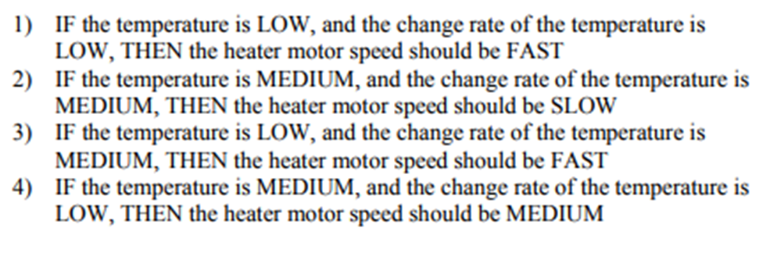
Membership function of temperature input
Membership function of temperature change input
Input:
35F and 1F/hr

Slide 38
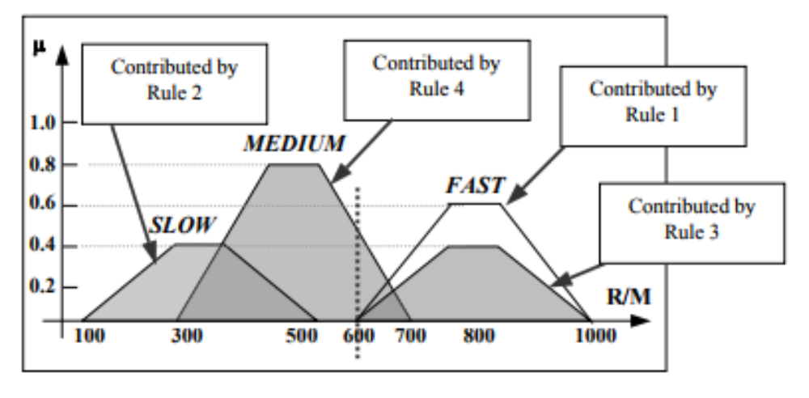

Example
Four sets of fuzzy outputs exist for a given pair of temperature and change of temperature
How to determine the crisp value to control the device?
CoG method
  Action is given by the center of the summed area, which is contributed by the different fuzzy outputs

Slide 39
What are the data analytics applications of Fuzzy Logic?
Can fuzzy logic be used for image annotation?

Slide 40
References
https://www.edureka.co/blog/fuzzy-logic-ai/
https://www.mathworks.com/help/fuzzy/types-of-fuzzy-inference-systems.html;jsessionid=6d0b605a29fa96472af9105b36f5
https://www.researchgate.net/profile/Robertas-Damasevicius-2/publication/313802182_Intelligent_tagging_of_online_texts_using_fuzzy_logic/links/599d1e0daca272dff12bdf13/Intelligent-tagging-of-online-texts-using-fuzzy-logic.pdf
https://jecei.sru.ac.ir/article_526_35eeea5f0f632cb283d22d78960d9308.pdf

